Slide 1
Environmental Justice Initiative Mitigating health threats in disadvantaged communities California Environmental Health Association 68th Annual Educational Symposium April 11, 2019
Angelo J. Bellomo, REHS, MS, QEP
Deputy Director for Health Protection

Slide 2
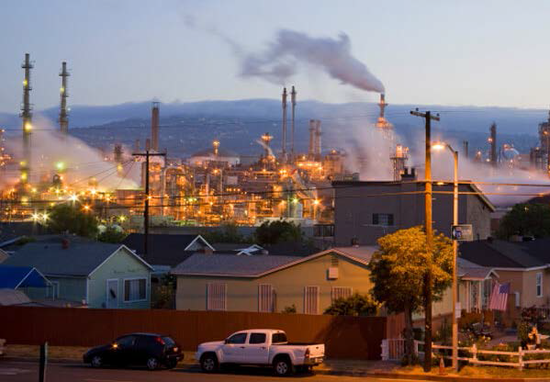
High risk facilities in proximity to people
Exposures
air pollution
criteria pollutants
toxic emissions
odors, dust
hazardous materials
noise & vibration
soil contamination

Slide 3
High risk facilities in proximity to people

Slide 4
Part 1 of 3 Case Study: Exide Battery Recyling Facility

Slide 5
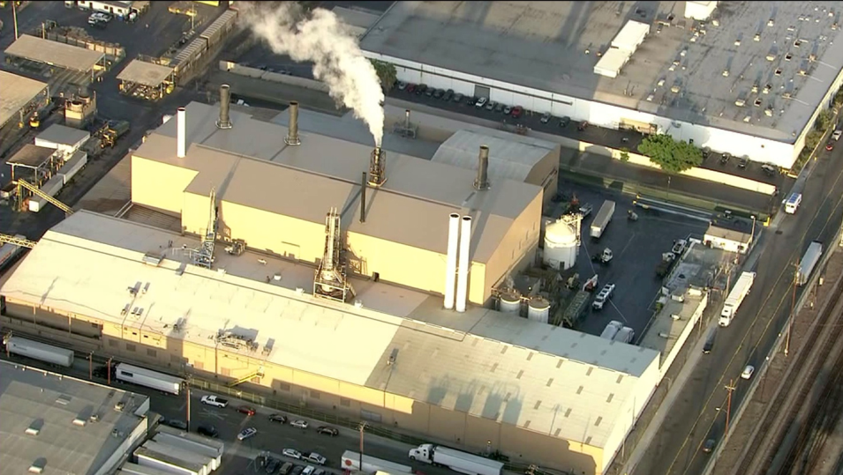
Exide Technologies Facilities Vernon, California

Slide 6
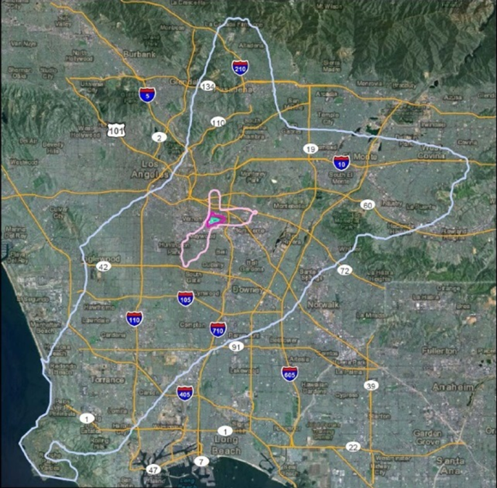
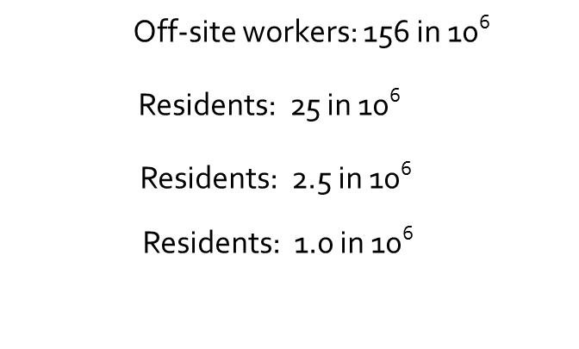
Exide Risk Assessment (Environ, 2013)
Max individual cancer risk attributable to Exide

Slide 7
Exide Timeline
1922: Facility operations begin
1940s: Smoke and “smog” issues emerge
1970s: Regulatory reforms; State 1972, Federal 1976
1990-2010s: Increasing public concern over health & safety
2013: Public release of AQMD Health Risk Assessment
2013: DPH & First District intervene and establish priorities
2014: Increasing State regulatory scrutiny
2014: DTSC prepares to issue or deny final permit for Exide
2014: DTSC enters into settlement with Exide
2015: US Attorney secures permanent facility closure
2016: DPH “rapid testing methods” (500 parcels in 10 days)
2016: DTSC certifies EIR and approves Residential Cleanup Plan
2016: Legislature/Administration Funding Plan $176.6 M
2017: Health Agency & First District “Community Outreach Event”

Slide 8
Challenge: DPH learns in 2013 that Exide’s operations in Vernon are contributing to an elevated public health risk to thousands in adjoining communities.
HOW DO WE RESPOND?
DPH establishes initial priorities - -
Operations to cease until State makes determination that the facility can operate safely.
Testing of soils and dusts in adjoining residential areas; and expedited cleanup of contaminated parcels.
Begin to address health needs and concerns of the community.

Slide 9
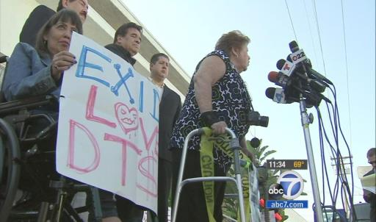
Community presses for closure of Exide (2014-2015)

Slide 10
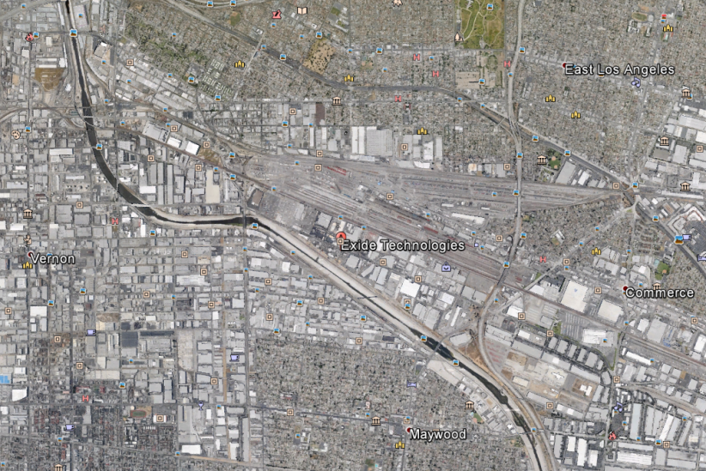
Widespread lead contamination in soils
2.0 mi
1.5 mi
1.0 mi
1500 ft
10,000 parcels within 1.7 miles

Slide 12
Celebrating Exide’s Closure, Ressurection Church, Boyle Heights
(March 15, 2015)

Slide 13
Developing situation May - Sept 2015
Exide permanently closed and stack emissions cease; focus shifts to contamination and cleanup.
Exide maintains other sources responsible for contamination. County concludes funding required from sources beyond Exide; total costs likely to exceed RPs willingness or ability to fund.
DTSC’s past performance indicates a need for continued County involvement to ensure public health is protected.
With proper investigation still lagging, DTSC asserts “contamination cannot be tied to Exide.”

Slide 14
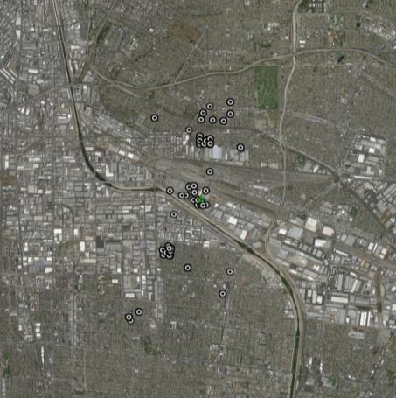
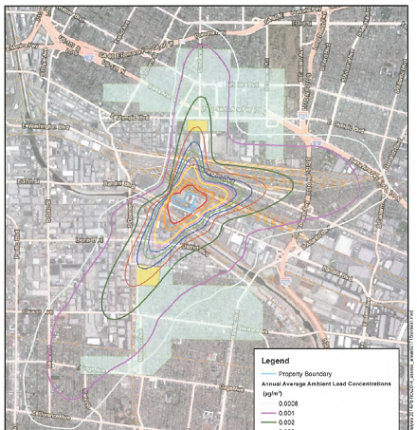
Antimony in soil surrounding Exide
Green Circle – ~1.6 miles
Blue Circle – ~2.1 miles
Stack Emissions Pattern (Environ)

Slide 15
Serving health needs in communities near Exide
Connecting patients to established medical providers and working with Medi-Cal to improve access to services.
Outreach to local clinical providers on key risk areas for their patients who live, or have lived, in areas potentially impacted by Exide.
Health screening for early detection, diagnosis, and treatment.
Blood-lead screening
Screening for childhood asthma; access to affordable medications
Early screening and interventions for children with learning difficulties and behavioral conditions.

Slide 16
STATUS CHECK:
Revised set of DPH priorities for Exide - 2015
Operations to cease until State makes determination on safety.
Testing & cleanup of soils and dusts in adjoining residential areas.
Begin to address health needs and concerns of community.
State’s use of “rapid testing methods” to expedite cleanup.
Greater State and/or RP funding for assessment & cleanup.
County to expedite State cleanup through political and legal means.
Comprehensive cleaning of “parkways” and home interiors.
Enhanced medical screening for early detection & treatment of disease.
Assessment of contamination in the industrial and commercial areas.

Slide 17
County’s role expands in Nov 2015 WHY?
Magnitude of Exide’s impact
3,458 tons (7 million lbs.) of lead released to air
Elevated health risk to more than 100,000 residents
Exide’s long record of non-compliance and criminal violations
State action stalls
Poor record of oversight; conflict of interest
State unclear as to appropriate course of action; resistant to acting with urgency

Slide 18
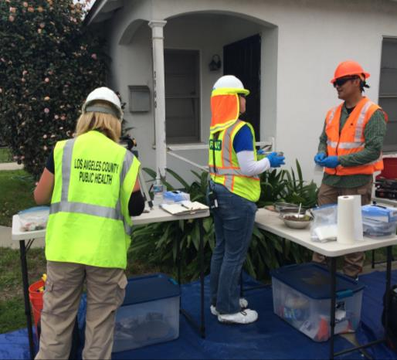
County DPH demonstration of “rapid testing methods”
DPH & Roux teams, Feb 29 – Mar 9, 2016
12 three-person teams sampled and tested for lead in soils
Use of direct-reading instruments
500 properties assessed in 10 days

Slide 19
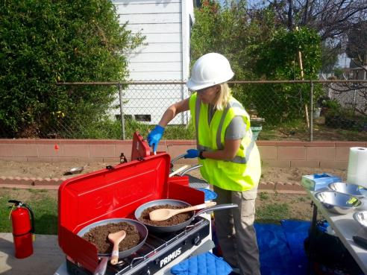
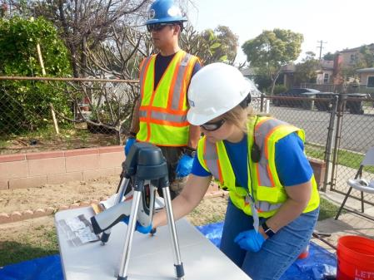
Question
What’s cooking on the gas stove?
scrambled eggs
ground turkey
dirt

Slide 20
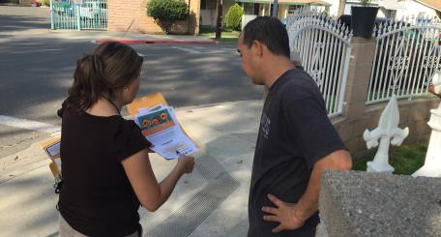
Next-day Results Provided to Residents
Residents received information explaining results
DPH staff gave guidance on interim risk reduction actions to reduce lead exposure

Slide 21
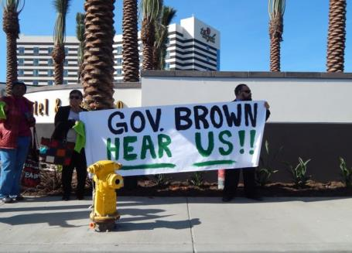
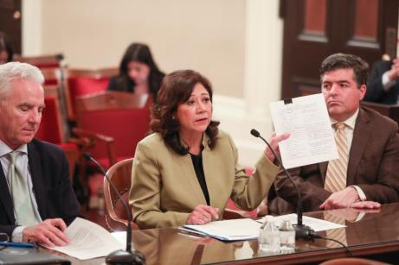
Legislative advocacy for changes in State residential cleanup plan (2016 – 2018)

Slide 22
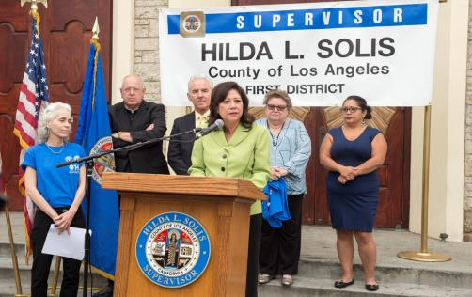
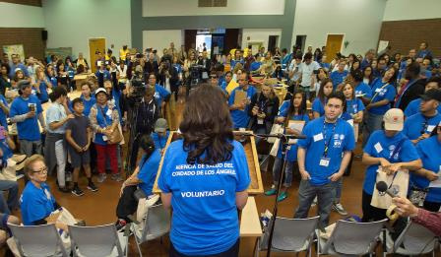
Community Outreach Event

Slide 23
Potential health effects of key chemicals emitted by Exide
Chemical | Health Effects
Lead | Lower IQ, learning disabilities, behavior disorders, hearing problems, and abnormal bone growth in children Increased risk of violent crime and delinquent behavior in teens and adults Kidney & nerve damage, anemia, and high blood pressure Problems with fertility, mood, memory, coordination, and vision
Benzene | Increased risk of cancer (acute myelogenous leukemia) Anemia, immune system problems
1,3-Butadiene | Increased risk of cancer (stomach, blood, and lymphatic system)
Arsenic | Increased risk of cancer (liver, bladder, lungs, and skin/soft tissue) Skin discoloration Lower life expectancy

Slide 24
What did the County & community partnership achieve?
The health threat of Exide’s continued operation came to light.
Exide’s closure secured by federal prosecutors.
State priority for cleanup moved from Exide facility to residential community.
Over $190 million in State funds allocated for residential cleanup.
State adopted “rapid field testing” as methods to expedite soil testing.
Massive community outreach to impacted residents of 21,000 homes.
DTSC mandated by Legislature to include cleanup of “parkways.”

Slide 25
Lessons learned in the Exide matter Local public health officials have an essential role in. . . . .
pressing for rapid action to abate environmental health threats that could otherwise persist indefinately;
working with State regulators to ensure decisions are health-protective; intervening as necessary to protect health;
providing the community with reliable information on hazards and health-protective measures;
promoting State and local policies to prevent new health threats and support mitigation of existing ones;
monitoring environmental conditions and health status to identify emerging threats;
partnering with communities to ensure their best interests are served, especially in disadvantaged communities where needs are greatest.
What more could LHOs do to mitigate and prevent health threats?
Notes:
1

Slide 26
Part 2 of 3 Environmental Justice: Public Health Implications

Slide 27
What is Environmental Justice?
U.S. EPA: “Fair treatment and meaningful involvement of all people regardless of race, color, national origin, or income with respect to the development, implementation and enforcement of environmental laws, regulations and policies.”
EPA suggests“EJ will be achieved when everyone enjoys the same degree of protection from environmental and health hazards and equal access to the decision-making process.”
Pennsylvania Dept of Environmental Protection: “Environmental justice embodies the principle that communities and populations should not be disproportionally exposed to adverse environmental impacts.

Slide 28
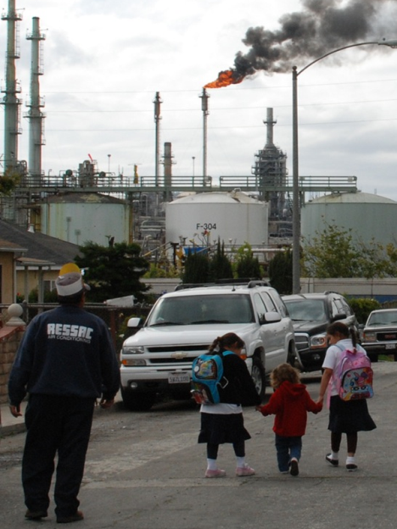
why do regulatory efforts fail to protect health?
what can be done to reduce exposures and associated risk?

Slide 29
land use decisions
socio-
economic disparities
regulatory inequities
environmental conditions
health disparities
Disproportionate
Burden
Factors contributing to disproportionate burden in disadvantaged communities

Slide 30
Factors contributing to development of a health threat
Contributing Factors | Exide | Paramount Cr⁺⁶ | Fruitland Fire | Fermin Oil Site | Aliso
Land-use decisions | X
Regulatory inequities | X
Environmental conditions | X
Socio-economic disparities | X
Health disparities | X

Slide 32
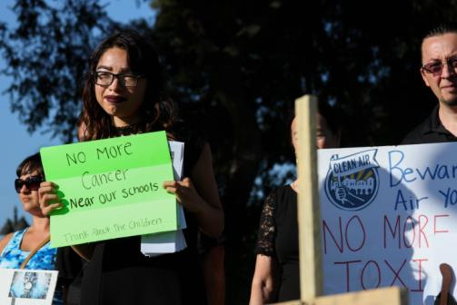
Hexavalent Chromium, City of Paramount
Active investigation into multiple industrial sources of hexavalent chromium in air
Numerous public health staff redirected to respond for over a year
Health Impacts
Increase risk of lung and nasal cancers
Nasal throat and lung irritation
Exacerbated breathing conditions

Slide 33
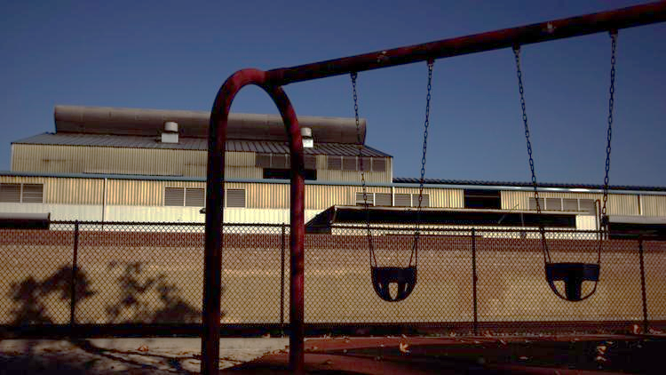
Hexavalent Chromium, City of Paramount
Source: LA Times

Slide 34
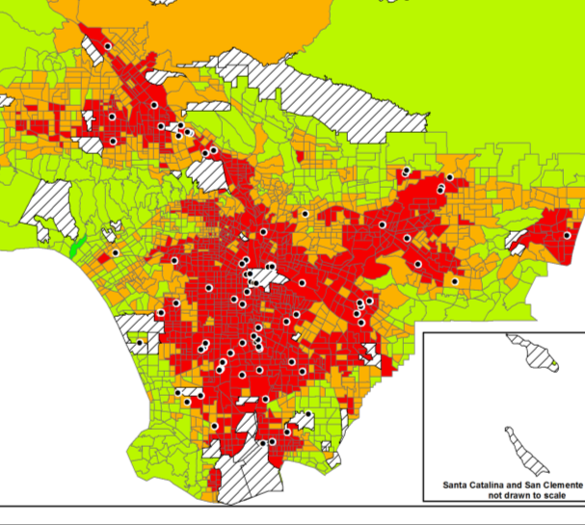
Chrome Plating and Anodizing Facilities in LAC

Slide 35
Factors contributing to health threat
Contributing Factors | Exide | Paramount Cr⁺⁶ | Fruitland Fire | Fermin Oil Site | Aliso
Land-use decisions | X | X
Regulatory inequities | X | X
Environmental conditions | X | X
Socio-economic disparities | X
Health disparities | X

Slide 36
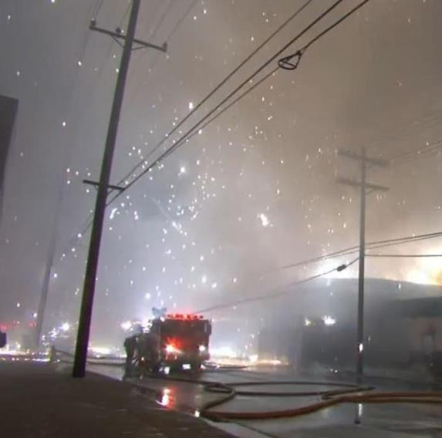
Fruitland Magnesium Fire, Maywood
Magnesium fire & explosion in salvage yard immediately adjacent to residential community
Residents experienced:
breathing difficulties
nausea, stomach ache
eye, nose & throat irritation
skin rash
depression
anxiety

Slide 37
Fruitland Magnesium Fire, Maywood

Slide 38
Factors contributing to health threat
Contributing Factors | Exide | Paramount Cr⁺⁶ | Fruitland Fire | Fermin Oil Site | Aliso
Land-use decisions | X | X | X
Regulatory inequities | X | X | X
Environmental conditions | X | X | X
Socio-economic disparities | X |  | X
Health disparities | X |  | X

Slide 39
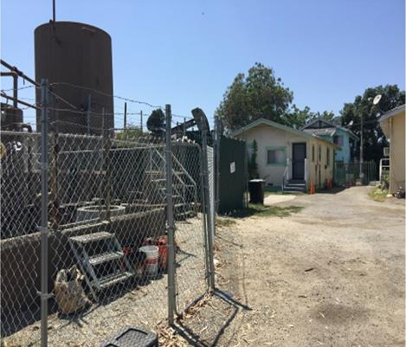
Fermin Street oil wells, LA Echo Park Community
State and City of LA plug two “orphan” wells in front yards of residential properties due to persistent “rotten egg” and petroleum odors
Process required operation of large industrial equipment within feet of residential homes
Health Impacts
Headache
Nausea
Exacerbated asthma
Skin rash
Anxiety from loud noise

Slide 40
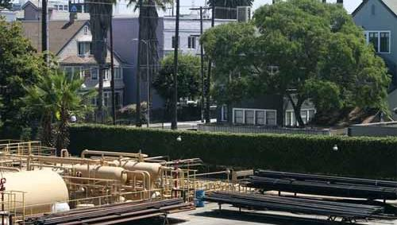
Allenco Facility, Los Angeles

Slide 41
Impacts of neighborhood oil and gas facilities
Report by DPH referenced health effects of oil and gas production facilities, including
birth outcomes
respiratory effects
neurological effects
gastrointestinal effects
dermatological effects
psychological effects

Slide 42
Factors contributing to health threat
Contributing Factors | Exide | Paramount Cr⁺⁶ | Fruitland Fire | Fermin Oil Site | Aliso
Land-use decisions | X | X | X | X
Regulatory inequities | X | X | X | X
Environmental conditions | X | X | X | X
Socio-economic disparities | X |  | X | X
Health disparities | X |  | X | X

Slide 43
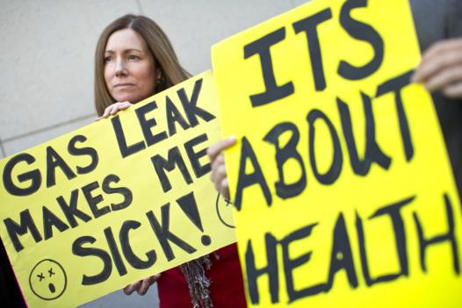
Aliso Canyon Gas Release, Porter Ranch
Methane leak caused health symptoms and forced relocation of residents
Required redirection of over 100 staff to respond
Health Impacts
difficulty breathing
nausea, vomiting, stomach ache
headache, dizziness
eye, nose, throat irritation
nosebleeds
cough

Slide 44
Factors contributing to health threat
Contributing Factors | Exide | Paramount Cr⁺⁶ | Fruitland Fire | Fermin Oil Site | Aliso
Land-use decisions | X | X | X | X | X
Regulatory inequities | X | X | X | X | X
Environmental conditions | X | X | X | X
Socio-economic disparities | X |  | X | X
Health disparities | X |  | X | X

Slide 45
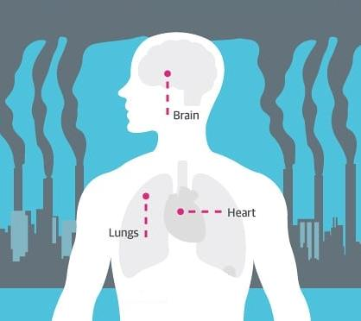
Health Impacts of Exposure to Pollution
Pulmonary function
Lung growth
Respiratory disease
Cardiovascular disease
Cancer risk
Brain growth and development

Slide 46
Disrupted Communities
Stress and Anxiety
Lifelong elevated health risks
Continued exposure

Slide 47
Part 3 of 3 Community Toxic Risk Reduction Program

Slide 48
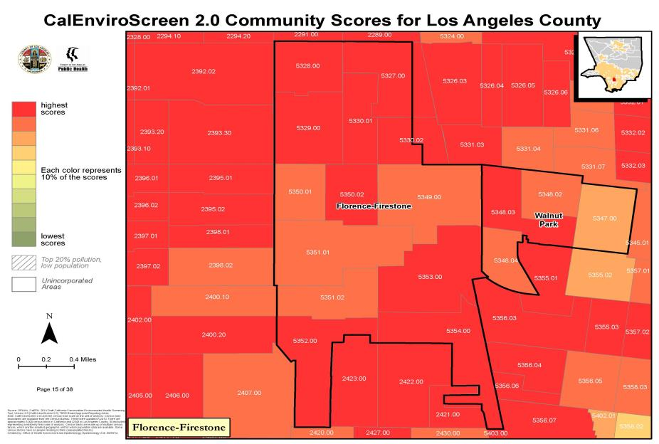
Most of the Florence – Firestone is ranked among the top 10% of pollution burdened areas in CA

Slide 49
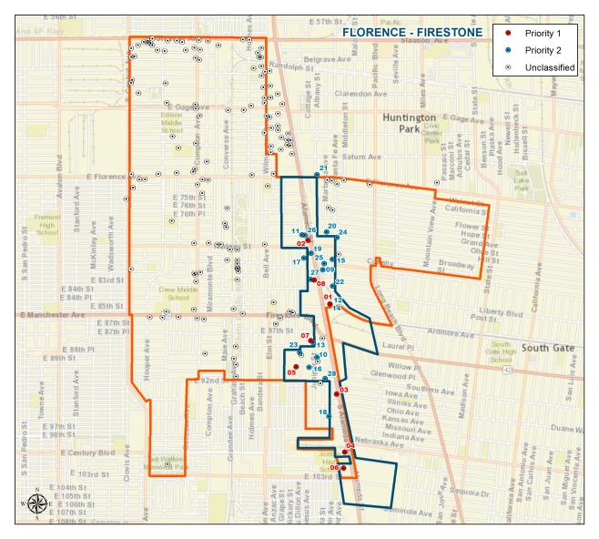
Pilot community: Florence-Firestone

Slide 50
Identify facilities contributing to risk
Screen agency records of permitted industrial facilities
South Coast AQMD
State DTSC
Others
Prioritize facilities based on:
nature of operations
history of compliance
Consult with community to compile final list of facilities where risk reduction is warranted

Slide 51
Target Facilities in Focus Area
ID # | Priority | Name | Type
01 | 1 | Jack Engle & Co | Metal Recycling & Salvage
02 | 1 | A & N Service Station Inc | Auto Body Shop & Repair
03 | 1 | California Body Shop | Auto Body Shop & Repair
04 | 1 | Atlas Iron And Metal Co | Metal Recycling & Salvage
05 | 1 | A-1 Welding & Ironworks Inc. | Metal Fabrication
06 | 1 | Express Welding | Metal Fabrication
07 | 1 | Noemi Powder Coating Noemi Cabrera-Soria | Printing, Painting, & Coatings
08 | 1 | Victory Salvage Inc. | Metal Recycling & Salvage
09 | 2 | Best Quality Furniture | Furniture Manufacturing
10 | 2 | Convenient Autobody | Auto Body Shop & Repair
11 | 2 | Dillano Auto Body | Auto Body Shop & Repair
12 | 2 | Engle Northern Parcel | Cleanup Site
13 | 2 | Fi Fo‘s Express | Auto Body Shop & Repair
14 | 2 | Firestone – Engle Southern Parcel | Cleanup Site
15 | 2 | Insurance Direct Collision | Auto Body Shop & Repair
16 | 2 | LA Co Road Dept | Fueling & Auto Repair
17 | 2 | Olympian Foam | Printing, Painting, & Coatings
18 | 2 | Wire Technology Corp | Wire Product Manufacturing
19 | 2 | A & A Radiator Factory | Auto Body Shop & Repair
20 | 2 | Avante Coach Works | Auto Body Shop & Repair
21 | 2 | Basto Auto Repair Inc | Auto Body Shop & Repair
22 | 2 | Central Metal, Inc. | Metal Recycling & Salvage
23 | 2 | Frontier Industrial Machinery Corp | Manufacturing
24 | 2 | Jesse’s Auto Repair | Auto Body Shop & Repair
25 | 2 | Molina’s Auto Body Repair | Auto Body Shop & Repair

Slide 52
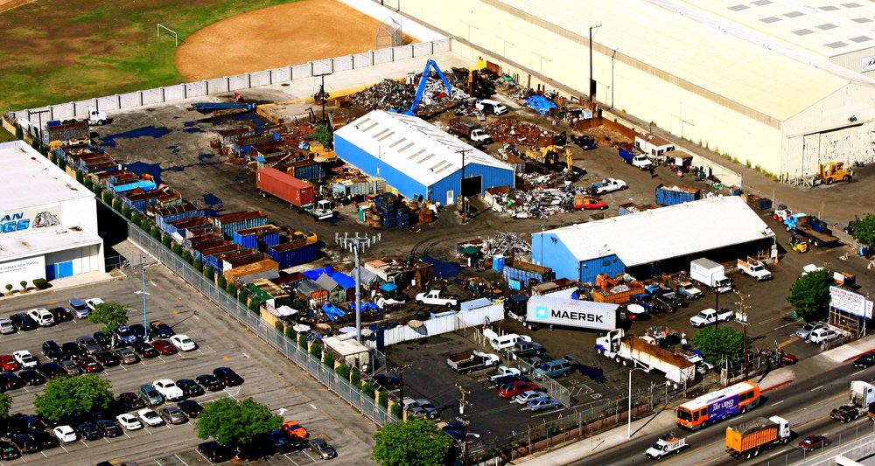
Atlas Metal Recyling Facility, Los Angeles

Slide 53
Vision for improved conditions in Focus Area
Strict Enforcement
Empowered
Communities
Strengthened Regulations
Higher Rates of Compliance
Fewer and Less Severe Emergency Incidents
Reduced Toxic Emissions
Improved Environmental Conditions
Notes:
As a result of major environmental threats like Exide, DPH has evolved its approach to environmental hazard prevention and preparedness. By applying Health Equity and Environmental Justice principles through our processes we are making changes towards closing the disparate gap in environmental conditions and promoting the fair distribution of environmental benefits and burdens.
Our vision for highly burdened communities includes:
Empowered communities more resilient to environmental threats
Strengthened regulations to protect population health
Higher rates of compliance among industrial facilities
Fewer and less severe emergency incidents
Reduced toxic emissions
Improved environmental conditions
Through the Board Priority and Leadership support, DPH leads the way in advancing environmental justice, toxic risk reduction and prevention of environmental emergencies in Los Angeles County communities that for too long have endured degraded environments and health disparities.

Slide 54
Approach to achieving improved conditions
Join community leaders in advocating for improved conditions; and encourage regulatory agencies to act with greater urgency.
Leverage combined authorities of local, State and federal agencies to bring targeted facilities into full compliance.
Increased compliance will lead to reduced emissions, exposures, and risks.
Increase monitoring of environmental conditions and health status to identify emerging threats.
Promote policy change at State and local levels to assist in prevention.
Notes:
Our Mission] To concentrate on the Highly Burdened Communities and reduce their cumulative risks.
To achieve this goal, the Department of Public Health is committed to collaborating with our colleagues both within and outside the traditional “health” sector. We are eager to engage new partners to create healthier and safer communities across Los Angeles County.
Collectively, we will need to be innovative while using comprehensive approaches that addresses the toxic emissions in low-income and minority communities affected by nearby industries and transportation hubs. The long-term goal is to establish policies that will reduce pollution and the health problems its causes.
A successful pro-active approach in dealing with toxic exposures in focused communities, reduces the need for reactive interventions like we are seeing now with Exide Battery plant and Aliso Canyon.

Slide 55
Population Profile – Florence Firestone
Population: 63,387 ♦ 3.58 sq. mile ♦ 17,705 people per sq. mile

Slide 56
Health Profile - Florence Firestone

Slide 57
Life Expectancy at Birth
County Average: 80.3 yrs
La Cañada: 87.8 years
Brentwood: 83.6 years
Flor-Firestone: 76.7 years
Westmont: 72.4 years

Slide 58
Risk reduction through prevention
Community Empowerment
inform community on pollution sources, compliance rates, health risks, and strategies for risk reduction
build relationships with community leaders
establish open, direct and honest communications with community members
help expand community capacity
encourage feedback throughout the process
Partner with Regulators
leverage combined authorities and resources of regulatory agencies to bring targeted facilities into full compliance
encourage regulators to keep focus of decision-making on public health protection
Work to establish joint agency reviews of non-compliant operations
Health Protective Policies
more effective land use conditions
alternative regulatory standards for areas where cumulative risks are elevated
public health guidance to inform decisions / reduce risks
Establish monitoring of environmental conditions and health status where residents and industry are in close proximity

Slide 59
land use decisions
socio-
economic disparities
regulatory inequities
environmental conditions
Addressing the
inequities to achieve
Environmental
Justice
health disparities

Slide 60
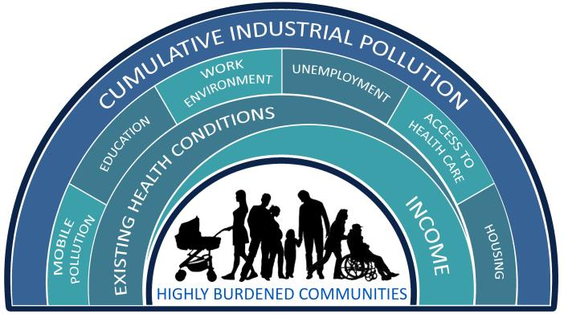
Highly Burdened Community
High Residential-Industrial interface
Inadequate green space
Government agencies reach conclusions/make decisions without first engaging the community

Slide 61
Well-Being

Slide 62
Thank you!

